Slide 1
01_opening_v2

Slide 2
02_primer

Slide 3
Requirements
Please watch the “Introduction to Inner Source” video:
http://bit.ly/inner-source-learning-path
Be familiar with agile or lean processes
Have a basic understanding of trusted committer and
contributor role

Slide 4
03_body_pt1

Slide 5
How Difficult it is to be Middle Management
Middle managers have higher rates of depression & anxiety
than their superiors and subordinates
More than half feel “constantly worried“
Middle managers are in the bottom 5% of job satisfaction*
* based on a survey of 320k employees by Harvard Business Review

Slide 6
Top 5 Common Complaints
Inheriting product chaos & dysfunctional teams
No flexibility & little room for creativity
Stress of dealing with politics & infighting
Rarely getting credit for all the work
Feeling like “bookkeepers“ or “enforcers“

Slide 7
04_body_pt2

Slide 8
Benefits Built into the Inner Source Process
Code is accessible
Planning is transparent
Documentation is accessible

Slide 9
Collaborating & Negotiating
Easier setting of expectations across teams
You can get other teams to help

Slide 10
Inner Source Examples
Payments – Refactoring and modularization
ALM – Application life cycle management
FDI – Failed developer interactions

Slide 11
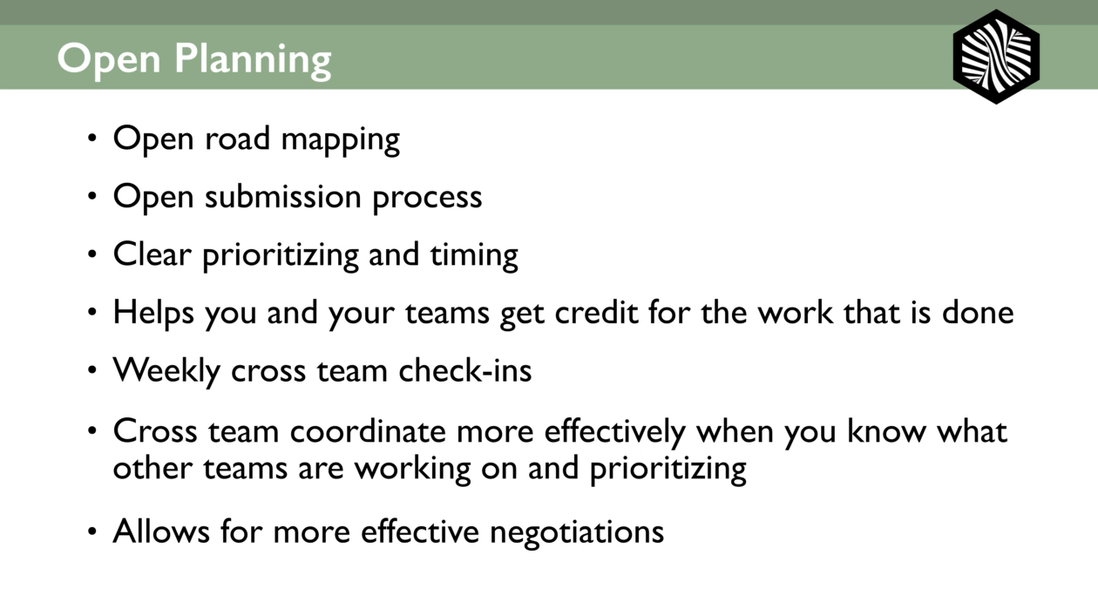
Open Planning
Need to clarify with Silona
(a) porpuse of slide
(b) what can be cut

Slide 12
05_body_pt3

Slide 13
New Roles & Responsibilities
Trusted committers
Other product owners
Documentation role and reporting up
Internal marketing

Slide 14
06_recap_takeaways

Slide 15
Wrap Up
Be kind – Being a middle manager can be tough
Key benefits
  Removing bottlenecks
  Obtaining more responsibility
  Collaborating with your peers to accomplish more with less
  Open process leads to more credit for your work
  Publishing your planning leads to less politics

Slide 16
Wrap Up
New roles & responsibilities
  Supporting your new trusted committers
  Working with other product owners
  Internal marketing

Slide 17
07_contact

Slide 18
Contact Us
innersourcecommons.org
twitter.com/innersourceorg
linkedin.com/groups/4772921

Slide 19
Find Me
silona.com
facebook.com/silona
twitter.com/silona
linkedin.com/in/silona
Instagram.com/silonaib

